Slide 1
OCR An Improved method to detect characters in images
ASIMINA SIMOTA ROY ROBERT CECIL | asimina.simota@pt.ibm.com
 | roy.cecil@pt.ibm.com

Slide 2
Background and technical Problem
What is the environment (the Technical Field) in which a problem arose. What needs to be known to understand your invention.
The understudy technical field is OCR. OCR stands for Optical Character Recognition, and it is a widespread technology used to transform handwritten or printed text into machine-encoded format. In order for someone to deeply understand the practices of our invention, he must have a solid understanding in image processing and deep learning methodologies. For the later one, we mainly focus on a specific type of neural networks ,the so called Generative Adversarial Neural Networks.
Describe the problem to be solved in this context and any constraint associated with. Express it As much as possible expressed independently from your invention.
Nowadays, automatic text recognition has become one of the most widely adopted technology solutions for businesses to control and enhance their business process. OCR solutions provide several advantages to business, such as ability to implement RPA solutions to improve business and client operations, increase in customer retention and satisfaction rate, and saving in costs and time required on the data entry task.
However, the computer application screenshots are usually in low resolution with artifacts and special effects, which makes word recognition a challenging task even after the text has been localized. Secondly, each computer application has its own page formating and structure, requiring thus, a quite dynamic image pre-processing parameterization. Well known valid techniques like the image thresholding and the kernels masks, must be avoided to eliminate overfiting and reduce the input image requirements. Finally, images that are generated by software applications, such as a software developer IDE, tend to have text with zero linguistic correlations and being very error prone. In the first case, common methodologies such a dictionaries can not be applied and in the second one, small errors can easily lead to a no sense output.

Slide 3
Background and technical Problem
Our main goal in this initiative is to create a quite generic OCR algorithm for computer applications, that automatically identifies the coordinates of each text character and efficient returns the recognition independently of the page formatting.For achieving the highest conversion accuracy in such an OCR system, it is required to solve the two main OCR optimization problems . First, identification of the position for each text character in the image (general problem category: Object detection) and second, recognition of each represented text letter in the image (general problem category: Object classification).
In the first optimization problem, common image preprocessing techniques can be used to exclude noise, delete redundant information, and highlight text regions in the image. Then, the initial image can be consecutively split into smaller sub images until only individual text characters are represented on them. This last process of the character isolation, is for every OCR algorithm the most challenging, time-consuming and error prone part of the project. The main issue of these techniques is, that they are converting the images into a binary representation format , which destroys all the color correlations coming from values such as saturation, RGB and hue. This color minimization process leads the close written characters to an intersection or broken state and makes their separation process almost impossible. Thus, an innovative method must be applied to increase the character detection accuracy in low resolution images.
In the second optimization problem, machine learning techniques can be used to create the algorithm for the character recognition. Specifically, a type of neural networks called convolutional neural networks (CNNs) is already recognized as an efficient machine learning technique, but with still some knowledge gaps in its optimal deep learning architecture. Furthermore, the biggest challenge in this process, is to find the appropriate input dataset for the training process of these Neural Networks. The existing character training datasets can be incomplete, expensive or with limited enriching capabilities (not applicable for different types of fonts, sizes, etc.). Thus, a different approach must be adapted to eliminate the above restrictions and add continuous learning capability in the process.
As a summary, our main technical focus can be divided into three main problem components:
Character detection in low resolution images and with intersected text for Latin characters.
Construction of synthetic Latin text-to-image data for training a character classification algorithm.
Identification of optimal convolution neural network evaluation method for Latin character detection.

Slide 4




Prior Art
List alternatives that you know or that you found by a quick search which could have been potentially a ‘correct’ solution to the problem.
Identify reasons why an obvious or known solution would not be the ‘ideal’ answer to the problem: what are the drawbacks of each (e.g., cost / performance / introduce a new problem / does not apply efficiently to the Technical Field / ...)
OCR major phases
Input Image
1. Pre-processing
2. Segmentation
3. Feature Extraction
4. Classification
5. Post-processing
Most of the existing Algorithms combine an outline flow as shown above with some minor variations. The steps are detailed in the following few slides
Description
Approaches
Weaknesees
Task to enhance input image quality.
▪Binarization d ▪Compression d ▪Morphological --- -operations
▪This kind of techniques convert the image into a two- tone array, which usually damages the original image relativities and lead to text deformation. Furthermore, they are making impossible the exploitation of other information factors such as RGB, saturation and hue. ▪Morphological operations such as erosion and dilation are very sensitive to the characteristics of the training images , thus there is a high risk for overfitting.
3.
4.
5.

Slide 5


Prior Art
d
Description
Approaches
Weaknesees
Task to separate image into its constituent text components. 1. text 2. words 3. characters
▪Connected -components d ▪Projection profiles s ▪Morphological -operations
▪Text in these images is divided into different logical areas each one representing its own set of semantics. Hence, the direct application of these techniques is not quite efficient. ▪Application images contain more special effect artifacts and are often subjected to degradations, including low resolution and small size for faster transmission rate. As a result, the developed segmentation techniques, often fail to produce satisfactory results. ▪In complex situations where the characters are broken, intersected or overlapped they can easily lead to misleading results. d
1.
Description
Approaches
Weaknesees
Task to define a set of important features to identify the character.
▪Geometrical s ▪Global ▪Statistical
d ▪The selection of a proper feature extraction technique is a crucial component for the performance of an OCR system. Various feature extraction techniques have been already implemented, but a rule of thumb is still under reserach. A method that is best suited for one application may not give optimum performance for another application. d
3.
4.

Slide 6


Prior Art
Weaknesees
s ▪With template matching a quite satisfactory classification accuracy can be achieved, but the recognition rate of this strategy is extremely dedicate to noise and input disfigurement. ▪Statistical classifiers they can achieve high but not exceptional recognition rates. Because of their nature, a single statistical classifier can be trained to get near perfect results but loses its capability when it is trained for a wide range of characters. ▪Neural networks can learn complex patterns in high dimension spaces with the proper multilayer design. Their key constraints are the large number of possible architecture candidates, the presence of the black box and their regional dependency for pair of characters with limited morphological differences. ▪Both statistical methods and neural networks require a signifficant quantity and variety of training data. The existing datasets can be incomplete, expensive or with limited enriching capabilities s D
Description
Approaches
Task to categorize a character into its particular class.
▪Template dmatching - d ▪Statistical dtechniques s ▪Neural Networks s
d
S
1.
Description
Approaches
Weaknesees
Task to improve accuracy of the OCR results.
▪Contextual dapproaches s ▪Multiple dclassifiers ▪Dictionary d
▪Computer applications may contain non-logic text such as IDs and coding scripts. Usage of dictionary-based methods have high propensity to introduce bias and damage the accuracy. Thus the avaiable ooptions are very limited.
3.

Slide 7
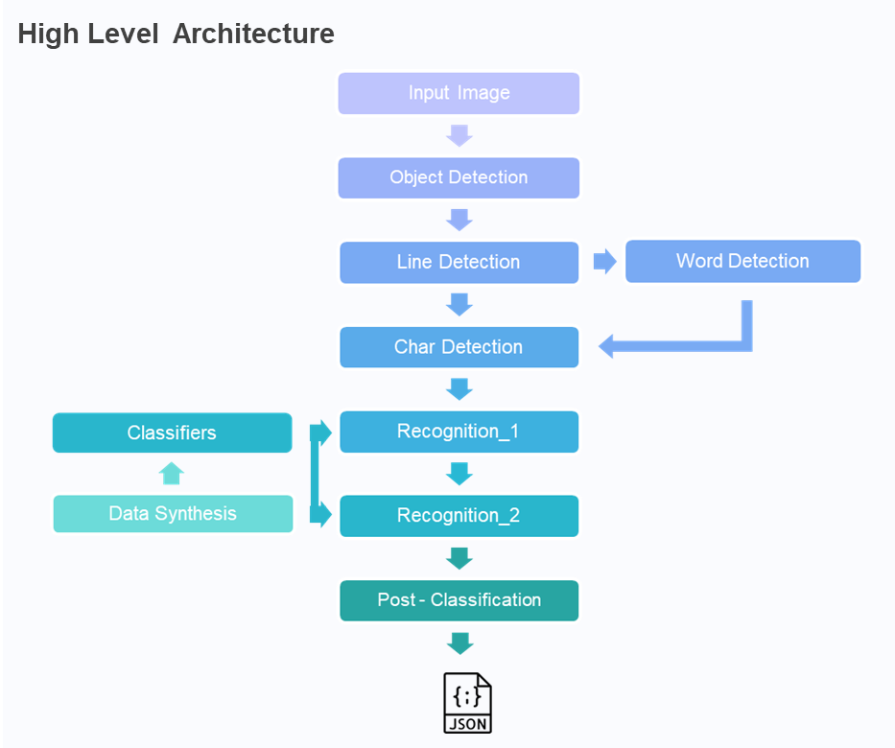
Technical Solution and preferred embodiment
Using1-2 drawings (e.g. block diagram, flow chart, architecture overviews), describe HOW your solution is implemented to be operated, by detailing the technical means and/or technical steps that cooperate to make your invention workable.
Our outline solution is described below that borrows some of the techniques from the prior art but has some innovative steps that as an overall method yields far better accuracy.
The proposed solution is inspired by the parallel computation practices and thus it is implemented with functions principle.
The focus area is OCR in Latin characters.
Object Detection | Segmentation of the image based on regional semantics.
Line Detection | Segmentation of the text lines.
Word Detection | Segmentation of the words when non sequential text is identified.
Char Detection | Segmentation of the text characters.
Classification_1 | Classification of the candidate character as a symbol, letter or number.
Classification_2 | Classification of the candidate character.
Post-Classification | Usage of fuzzy algorithm to improve the results.
Implementation and Arguments

Slide 8

Technical Solution and preferred embodiment

Slide 9

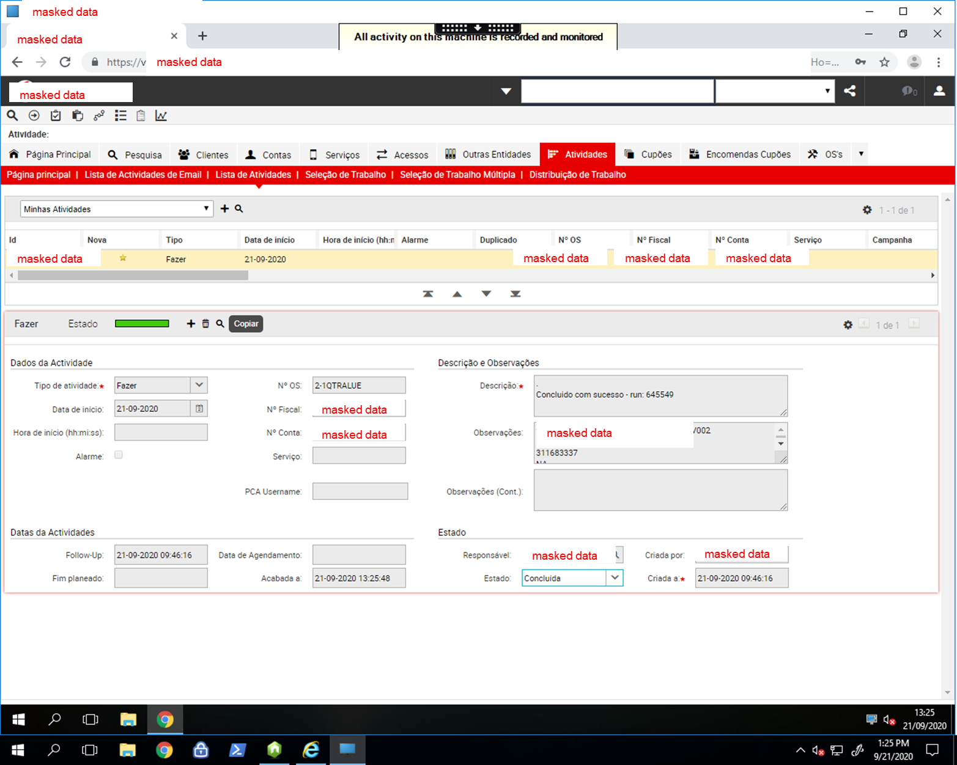
Technical Solution and preferred embodiment
Morphology
The size of the understudy images varies between 6KB to 878KB. The maximum resolution is 2400x1848 pixels. The minimum resolution is 58x455 pixels. The images contain various colors and special effects icons. Icons are placed very close to the text. The text is distributed among the whole image. s D

Slide 10

Technical Solution and preferred embodiment

Slide 11
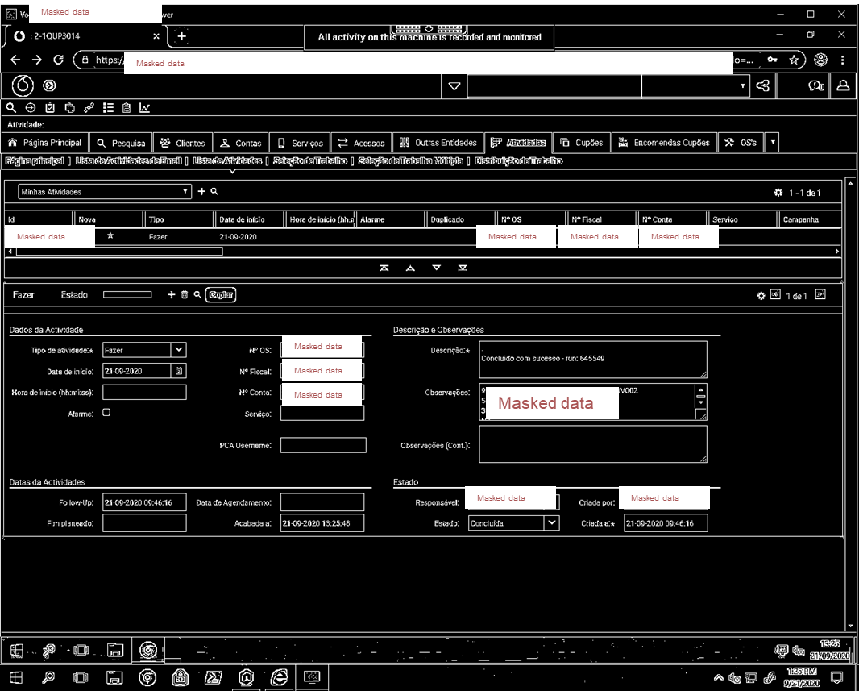
Technical Solution and preferred embodiment
Object Detection – Step 1
The input image is binarized to highlight only the areas of interest. Commonddmorphological operations such as deliation and erosion are not used in this step. Their usage is avoided because at this level they introduce error in the process. The image binarization is inverted to give the value 1 to regions of interest and 0 to the rest. This decision is experimental and is highly connected with the neural networks optimization that will be applied in a later phase. The idea is to direct the gradient descents and hence the learning rate closer to the text. D

Slide 12
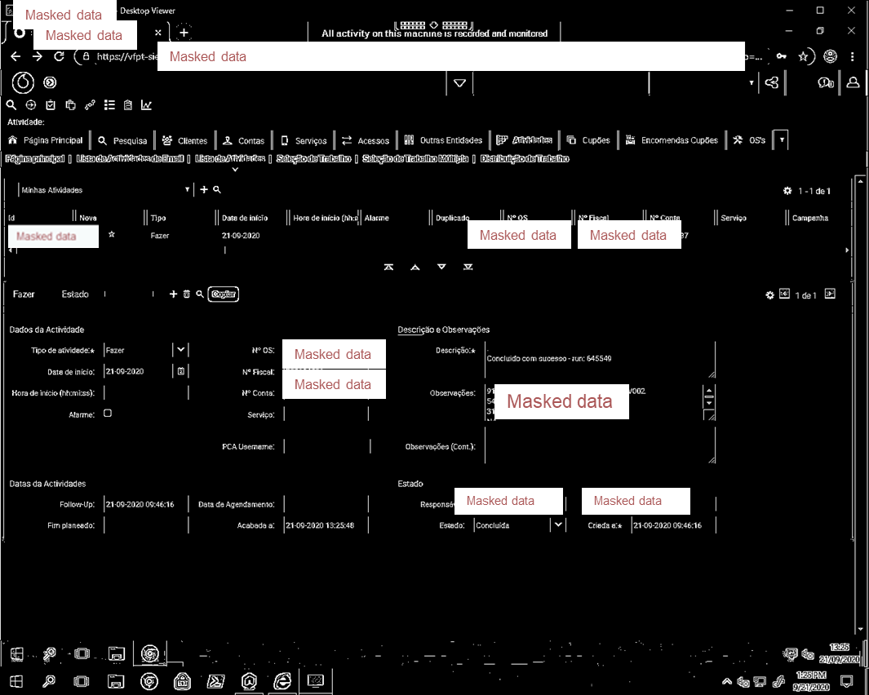
Technical Solution and preferred embodiment
Object Detection – Step 2
The horizodal lines are removed using morphological transformations. To keep the solution generic and avoid overfitting a custom method identified that correlates the size of the excluded lines with the image height and width.

Slide 13
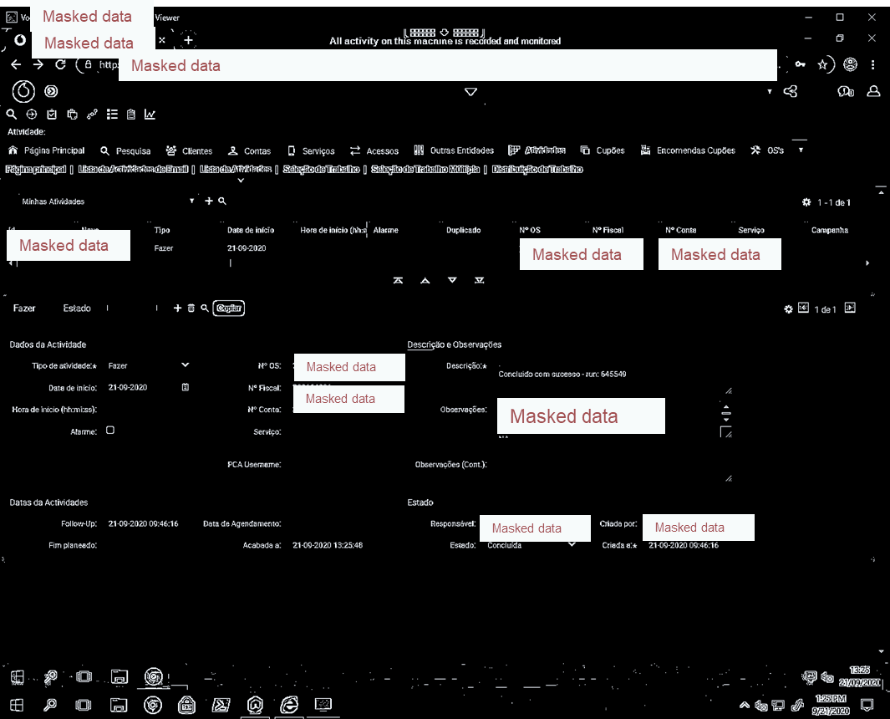
Technical Solution and preferred embodiment
Object Detection – Step 3
The vertical lines are removed using morpgological transformations. Some minor vertical lines are remaining in the image because their exlusion will affect also the text.

Slide 14

Technical Solution and preferred embodiment
Object Detection – Step 4
A custom deliation method is applied to increase the white area in the image and join the broken object parts. Common kernel deliation technique is avoided because the dynamic nature of the image attrubutes makes this operation unstable. Our custom method allows to increase more the white color where the regions are correlated and less in the rest.We named it: 'expotential white'

Slide 15

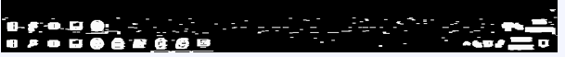
Technical Solution and preferred embodiment
Object Detection – Step 5
Noise is removed using contours size filtering. The amplitude of the fiiltering conditions is very narrow to guarantee that any text point is excluded.
State at previous step 4

Slide 16

Technical Solution and preferred embodiment
Object Detection – Step 6
Icons and special effects are removed using a second contours size filtering. The parameteres for the filter are defined after testing and considering the correlation between character height and width in any image. The redundant information are filtered gradually and with low intensity to guarantee that text is not affected. This gradual removal of noise and icons is adapted also to secure the generalization ability of the solution.

Slide 17
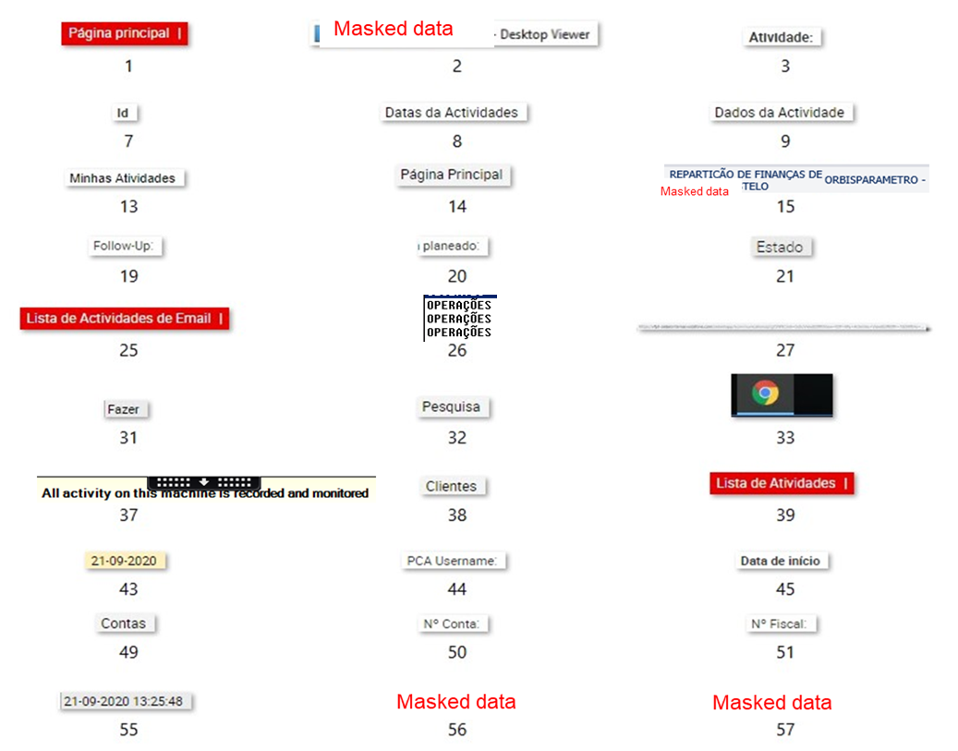
Technical Solution and preferred embodiment
Object Detection – Step 7
Finally, the text object segments are extracted ,having a small noise error.Their coordinates are stored in a dictionary for the final text represenation or to support an RPA process. The object segments are coming from the original color image. We named this task: ‘clean canvas' The ‘clean canvas’ methodology is used at the end of each solution phase of the algorithm. This decision gives the flexibility to adjust every time the preprocessing parameters based on the understudy problem. Also, it allows to take advantage of attributes that they introduce noise in one step, but they are useful in another.

Slide 18

Technical Solution and preferred embodiment

Slide 19
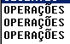
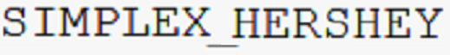


Technical Solution and preferred embodiment
Line Detection – Step 1
(a)
(b)
The output of the object detection is now split into line segments if this object containts more than 1. The input image is binarized and morphological operations are applied on it. The parameters are different from the previous phase as it is explained with the ‘clean canvas’ methodology. Their size is smaller now and we focus only on the vertical distribution of the text.

Slide 20
Technical Solution and preferred embodiment
Line Detection – Step 2
The image is segment into lines when between the white areas black horizal gaps exists. There is an experimental minimum distance threshold defined to avoid distinguish correlated objects. Like the second example (b). During this operation, redundant information such as the image borders are also excluded.
(a)
Correct
(b)
Error

Slide 21
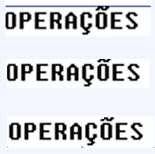
Technical Solution and preferred embodiment
Line Detection – Step 3
(a)
Finally, the line segments are extracted and their coordinates are stored in a dictionary for the final text represenation or to support an RPA process. The line segments are coming from the original color image. 'clean canvas'
(b)
(b.1)
(b.2)
(b.3)

Slide 22

Technical Solution and preferred embodiment

Slide 23


Technical Solution and preferred embodiment
Word Detection – Step 1
The output of the line detection phase is now split into word segments if it contains uneven text. The input image is binarized and morphological operations are applied on it. The parameters are different from the previous phase. Now we focus on the intensity of the relationship between the white pixels.

Slide 24
Technical Solution and preferred embodiment
Word Detection – Step 2
To identify lines with uneven text a custom statistical method created. We named the method 'uneven quartiles'. The method works as following.The candidate image is split into batches.Based on each batch it is measured the maximum difference between white pixels in ~Q1 and white pixels in th ~Q3. If the total amount of white pixels is signifficant different that the maximum value, the image is classified as 'uneven’.
Q3 1
Q3 2
Q3 3
Q3 4
Q3 5
Q3 6
Q1 1
Q1 2
Q1 3
Q1 4
Q1 5
Q1 6
1. Max = Q1_3 – Q3_3
2. Class =Max/sum(Q1)
uneven

Slide 25
Technical Solution and preferred embodiment
Word Detection – Step 3
Finally, the word segments are extracted and their coordinates are stored in a dictionary for the final text represenation or to support an RPA process. The word segments are coming from the original color image. 'clean canvas’
At this level, the quality of the segments is already very satisfactory. Because our application is separated into phases , the output of this process can be utilized by any open-source or payed OCR solution to improve its performance. The results are already tested with Tesseract, and they are revery liable.
!
Notes:
Add examples

Slide 26

Technical Solution and preferred embodiment

Slide 27
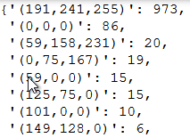
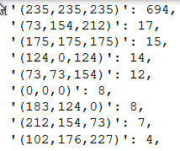
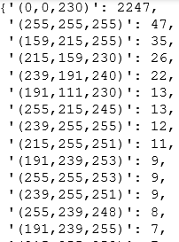
Technical Solution and preferred embodiment
Char Detection – Step 1
The output of the line or the word detection phase is now split into character segments. Morphological operations are not applied. Images are processed in RGB format to consider this important color correlation factors in the analysis. The first step is to create a dictionary for each understudy image with all the contained BRG colors, plus their corresponding counts. The BRG color with the highest frequency it is classified as the backround color. Is not very visible in this presentation but these low resolution images contain a large amount of colors. 81,91 and 140 colors respectively.
(a)
(b)
(c)
Notes:
Add examples

Slide 28
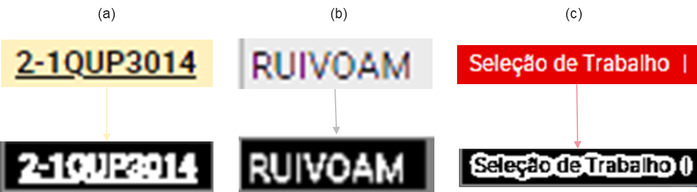
Technical Solution and preferred embodiment
Char Detection – Step 2
The next step of the process is to decrease the color dimensionality.It is impossible to identify letter attributes in such multidimensional color level. One option is to use the image binarization technique. But, the large amount of colors and the small saturation values in between the letters, makes this process quite unstable. So, to decrease the colors we apply a 2-steps custom method. We named the first step of the method ‘background distance’. Scope of this method is to identify all the color shades that are closer to the background color and normalize them. To achieve this, we compare the minkowski distance of each candidate color from the background color and the median value of the color dictionary. The results are not visible at a glance, but now we have 61, 77 and 112 colors respectively.
91 colors
77 colors
(a)
81 colors
61 colors
(b)
140 colors
112 colors
(c)
Binarization Error

Slide 29



Technical Solution and preferred embodiment
Char Detection – Step 3
The second step of the custom dimensionality reduction method, we named it ‘quantization’. A k-means cluster algorithm is used to automaticly identify for each image the 2 BRG color centroids and tranform it in a 2 color represenation format. This unsupervised color reduction technique gives us the following advatnages:
(a)
(b)
(c)
flexibility to work in any level of the dimensional space and take advantage of different attributes such as color shades and multidimensional mathematics. (under research)
reduces signifficant the number of intersected letters, which is the main issue in these low resolution by using kernels.

Slide 30



Technical Solution and preferred embodiment
Char Detection – Step 4
The next step before the character segmenation is to excude horizontal and vertical lines from the images. For the underlines lines a custom method was created because common hough transform techinique was very sensitive to parameters. We named it ‘underline check’. The main idea is to find horizontal text color gaps with a minimum threshold value. This method gives the capability to isolate only underline words. For the vertical lines and the remaining horizontal ones hough transform technique is adapted.
(a)
(b)

Slide 31




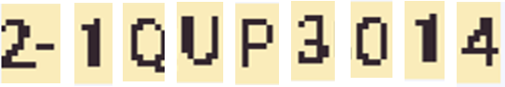


















Technical Solution and preferred embodiment
Char Detection – Step 5
The next step is the character segmentation. We are going to use the outputed transformed images from the previous steps. Morphological opeations are not applied. A custom 2-steps fuzzy method was created to fullfill this task. In its first step, the images are split into smaller pieces based on vertical gaps in between the text color. Those with small resolution and large x axis are considered interesected and they are moving to the second step for futher analys.The rest are classified as unique character segments.
(a)
(b)
(c)

Slide 32
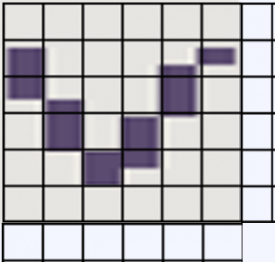
Technical Solution and preferred embodiment
Char Detection – Step 6
In the second step of our custom method the characters are segmented based on pixel patterns. We named this step ‘pixel chronos’. The main idea is to isolate character segments by treating pixels evolution as a time vector. The basics steps are the following:
V trend
1
2
3
4
Create a feature vector with only the top letter pixels.
Create a feature vector with only the bottom letter pixels
Check the trend of the top_feature_vector to identify if a consecutive predefined pattern is appeared. The patterns are:
3.1 check for m
3.2 check for k
3.3 check for v and w
3.4 check for M and N
3.5 check for U
3.6 check if it goes down and up
3.7 check if it goes down - down up
If there is some pattern uncertainty the bottom_feature_vector is used to check for pixel intensity patterns.
If a pattern exists, the character is segmented, and the process is repeated for the remaining pixels.
image y axis
5
6
1
2
3
4
5
6
image x axis
Top_feature_vector = [2,3,5,4,2,2]
Bottom_feature_vector = [3,4,5,5,3,2]
Example in the next slides

Slide 33
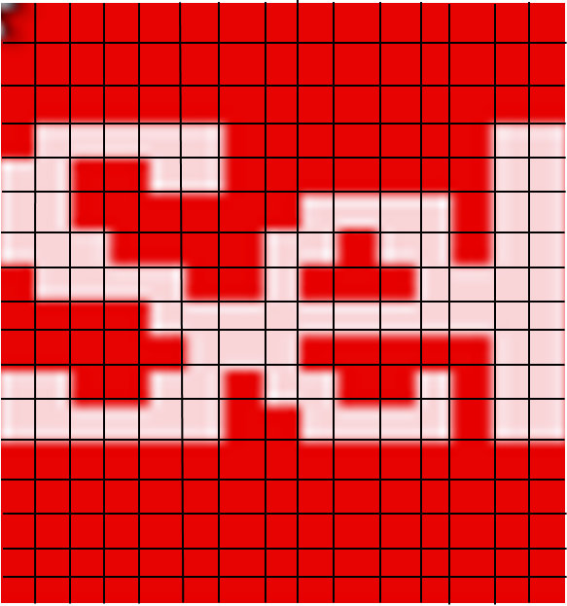
Technical Solution and preferred embodiment
Example Demo for Char Detection – Step 6
1
Step 6.1
2
3
Generate the feature vectors:
4
Top_feature_vector =
[0,3,2,2,2,2,2,7,5,4,4,4,4,6,2,2]
5
Bottom_feature_vector =
[0,10,10,10,10,10,10,8,9,10,10,10,10,7,10,10]
6
7
8
The first element of each feature vectors is always 0.
9
10
11
1
2
3
4
5
6
7
8
9
10
10
11
12
13
14
Notes:
Add examples

Slide 34
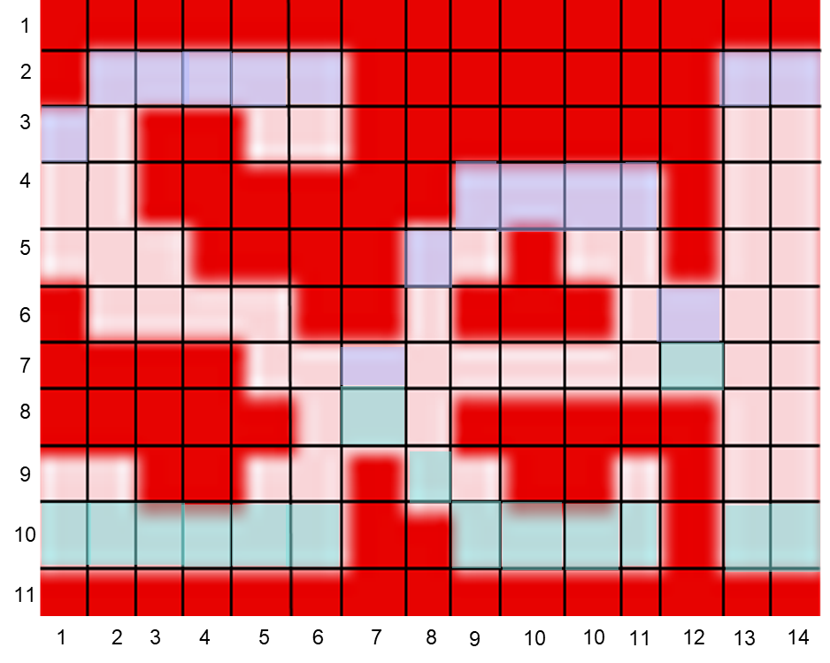
Technical Solution and preferred embodiment
Example Demo for Char Detection – Step 6
Step 6.2
Top_feature_vector =
[0,3,2,2,2,2,2,7,5,4,4,4,4,6,2,2]
Trend _top_feature_vector = - 1, t=2
At time 2 the trend of the top_feature_vector is 2 – 3 = - 1. This trend is increasing. Hense, characters v, V, M, m, W, w, N, k, K are excluded for the pattern detection.
Notes:
Add examples

Slide 35
Technical Solution and preferred embodiment
Example Demo for Char Detection – Step 6
Step 6.3
Top_feature_vector =
[0,3,2,2,2,2,2,7,5,4,4,4,4,6,2,2]
Trend _top_feature_vector = -0, t=3
At time 3 the trend of the top_feature_vector is 2 – 2 = 0. This trend is stable. Hence, we assume that we are in the midde of a letter and we can move on.
Notes:
Add examples

Slide 36
Technical Solution and preferred embodiment
Example Demo for Char Detection – Step 6
Step 6.4
Top_feature_vector =
[0,3,2,2,2,2,2,7,5,4,4,4,4,6,2,2]
Trend _top_feature_vector = -0, t=4
At time 4 the trend of the top_feature_vector is 2 – 2 = 0. This trend is stable. Hence, we assume again that we are in the midde of a letter. We can move on again.
Notes:
Add examples

Slide 37
Technical Solution and preferred embodiment
Example Demo for Char Detection – Step 6
Step 6.5
Top_feature_vector =
[0,3,2,2,2,2,2,7,5,4,4,4,4,6,2,2]
Trend _top_feature_vector = -0, t=5
At time 5 the trend of the top_feature_vector is 2 – 2 = 0. This trend is stable. We assume that we are still in the midde of a letter and we move on.

Slide 38
Technical Solution and preferred embodiment
Example Demo for Char Detection – Step 6
Step 6.6
Top_feature_vector =
[0,3,2,2,2,2,2,7,5,4,4,4,4,6,2,2]
Trend _top_feature_vector = -0, t=6
At time 6 the trend of the top_feature_vector is 2 – 2 = 0. This trend is stable. We assume that we are still in the midde of a letter and we move on.

Slide 39
Technical Solution and preferred embodiment
Example Demo for Char Detection – Step 6
Step 6.7
Top_feature_vector =
[0,3,2,2,2,2,2,7,5,4,4,4,4,6,2,2]
Trend _top_feature_vector = 5, t=7
At time 7 the trend of the top_feature_vector is 7 – 2 = 5. This trend is decreasing. There a potential intersect between characters!!!! The next following trends must be checked to verify this.

Slide 40
Technical Solution and preferred embodiment
Example Demo for Char Detection – Step 6
Step 6.8
Top_feature_vector =
[0,3,2,2,2,2,2,7,5,4,4,4,4,6,2,2]
Trend _top_feature_vector = 5, t=7
Trend _top_feature_vector = -2 t=8
Trend _top_feature_vector = -1, t=9
The top trend at time 7 is decreasing. The top trend as time 8 is increasing. The top trend at time 9 is increasing/stable. The identified pattern is down-up , which indicates a letter intersection.

Slide 41
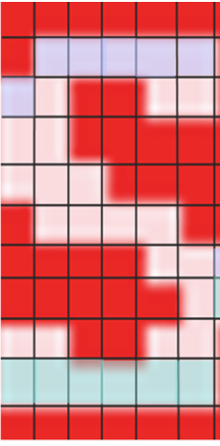
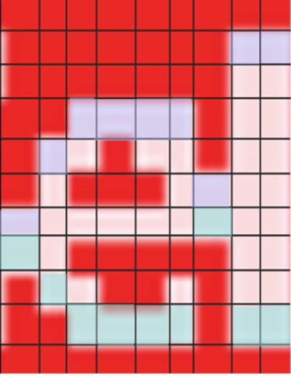
Technical Solution and preferred embodiment
Example Demo for Char Detection – Step 6
Step 6.9
After the pattern identifixation , the image is split and the first character segment is extracted. The process is repeated for the remaining pixels.

Slide 42

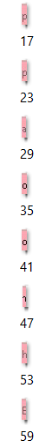
Technical Solution and preferred embodiment
Char Detection – Step 7
Finally, all the character segments coordinates are stored in a dictionary, for the final text represenation or to support an RPA process.

Slide 43

Technical Solution and preferred embodiment

Slide 44
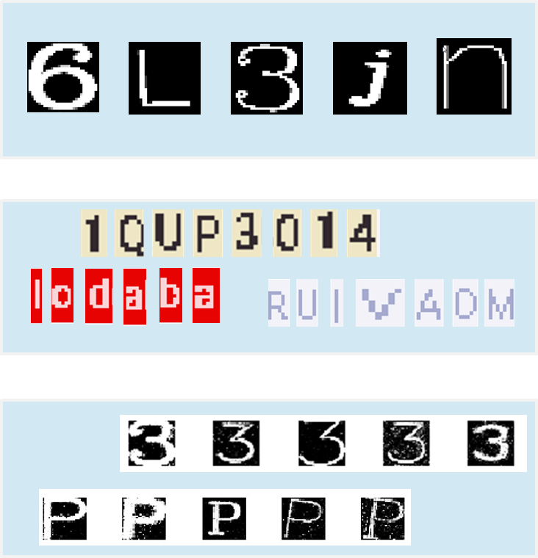
Technical Solution and preferred embodiment
Data Synthesis – Step 0
To train the letter classifier 3 types of data image sources are used. D
Train dataset
1. Machine Font Data
Auto Labaled data, created by using regular machine font data such as Arial, Calibri and so on. Manual Labeled data, created by using extracted data from our train images. Synthetic unreal Labeled data, generated by training Generative Adversarial Neural Networks (GANs).
2. Labeled Data
GANs are used to increase the classification accurcay and the stability by adding unknown and unpredicted noise variation into the train dataset.
3. GANs

Slide 45
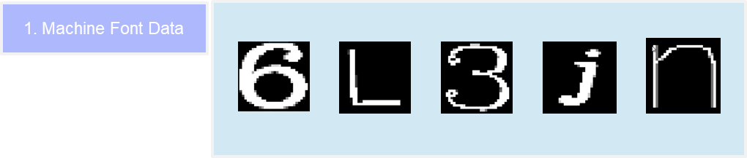
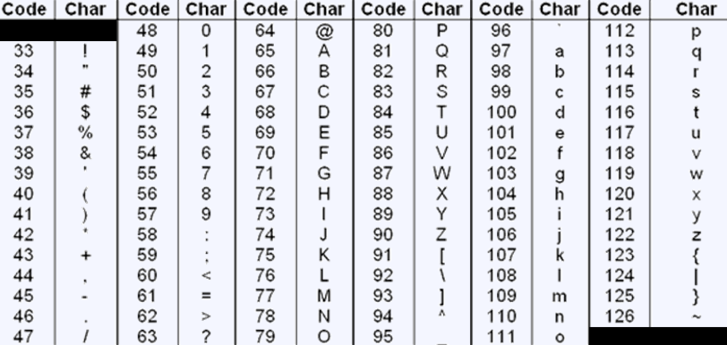
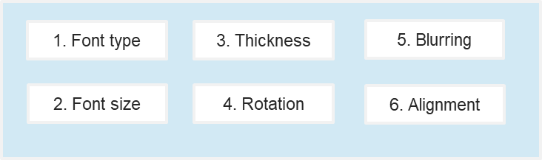




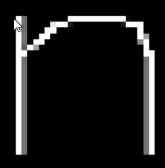
Technical Solution and preferred embodiment
Data Synthesis – Step 1
Data Samples
The first step of the data synthesis phase is to create a solid, diverse and efficient base train dataset with labeled character images.For this prototype we used OpenCV standard fonts, but we can extend this to any regular computer machine font. For the data labels identification, the character encoding standard ASCII table it is used. To increase the entropy of the train dataset several attributes´ parameters are combined. Different font types, letter thicknesses, blurring levels, font sizes, letter aligments and angles. The train images are binary inverted where the letter pixels receive value 1 and the backround value 0. This decision is experimental and is higly connected with the neural networks optimization that will be applied for the classification. The idea is to direct the gradient decents and hence the learning rate and the weights cloder to the character charctertiscs. The dataset is created in-memory and it has the format of an api. This makes the solution portable and the train dataset quite adjustable. The idea is to change on demand the format, the entropy or its balance and serve a specific learning need or strengthen the accuracy of a weak class.
ASCII Table
Letter Attributes

Slide 46
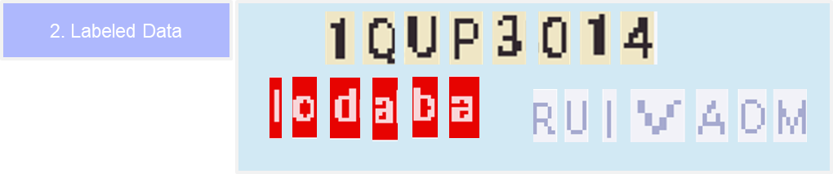




Technical Solution and preferred embodiment
Data Synthesis – Step 2
The second step of the data synthesis phase, is to enrich the variation in the already created train dataset.To achieve this, we label and add in the sample the extracted data from the character detection phase. Morphological operations are applied to binarize the input images. Scope of this step, is to increase the recogntion accuracy of the model and add continous learning capability in the solution. In longterm, the solution accuracy will increase in a parallel way with its usage dynamics. ‘The more it is used the better it performs’.
Input Image | Train Image | Label |  | Input Image | Train Image | Label
 |  | 97 |  |  |  | 65
 |  | 100 |  |  |  | 101
 |  | 80 |  |  |  | 49

Slide 47
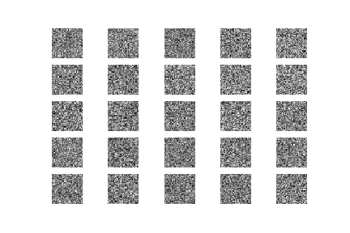
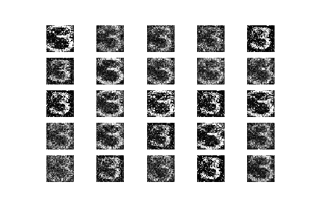
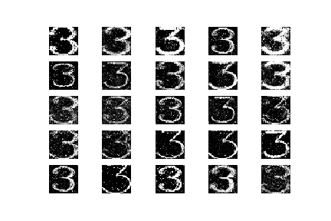
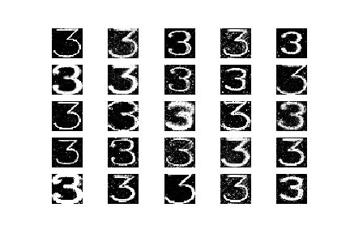
Technical Solution and preferred embodiment
Data Synthesis – Step 3
Train process Graph
The third step of the data synthesis phase is to decrease the noise or the effect of the ‘disruptive term‘. In statistics the ‘disruptive term‘ describes the variation of all the unknown model information. Our idea is to decrease the unknown information level by creating artificial characters, or specifically, characters that its not possible to be produced by any computer machine. To achieve this, a custom method using Generative Adversarial Neural Networks (GAN) was created. We named it ‘unreal characters‘. In this method 94 GANs were trained, one for each latin character. The base dataset for step 1 was used as the evaluating input. The train process stops on 8000 epochs to avoid data overfiting and also to keep some random noise in the generated images.
Start
letter
Base Data
Train GAN
Save Model
END
Segment
Train process evolution
0 epochs
400 epochs
2800 epochs
8000 epochs

Slide 48
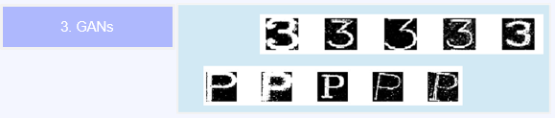
Technical Solution and preferred embodiment
Data Synthesis – Step 4
The created models are running seperately as an api and they generate data in-memory or in disk. This way, the execution of the solution can take advantage of the parallel computing practises and provide the data in a flexible, portable and easy usable format. The generated amount of ‘unreal characters‘ is manualy imporetd by the user. This decision allow us to control the influence rate in the final character classification phase. The models were created with continuous learning capability. In long-term it is expected for GANs to take advantage of the data entered by the application users to improve their diversity output and decrease more the ‘disruptive term‘.
Generate data process
Score GAN
Images
END
Start
Quantity
Segment

Slide 49
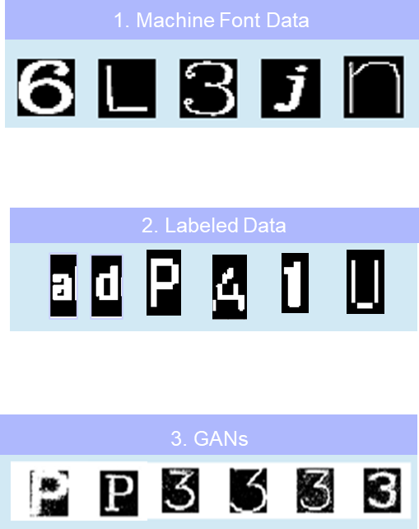
Technical Solution and preferred embodiment
Data Synthesis – Step 5
Finally the 3 data sources are combined and together they constitute our integrated training dataset for the final classification of the character segments. Key point: data source 1 (Machine Fonts) and data source 3 (GANs) were created as flexible in-memory apis. This means, that their contribution and influence rate can be controled or changed in the future if its necessary.
Train Dataset

Slide 50

Technical Solution and preferred embodiment

Slide 51
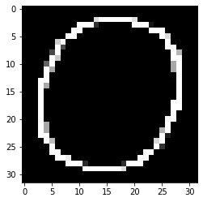

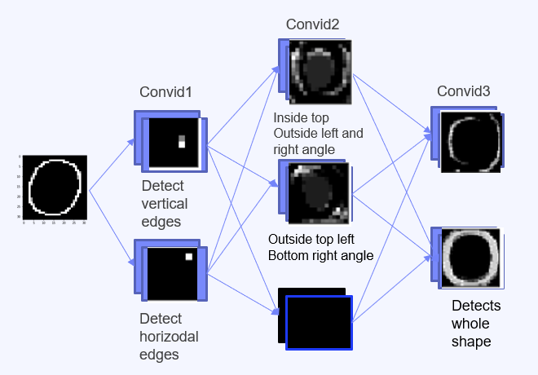


Technical Solution and preferred embodiment
Classifiers – Step 1
1. Spatial Invariance
2. Pattern Invariance
To selected classifier to build the recongntion models is Convolutional Neural Networks (CNNs). CNNs are fast, easily trainable and have 4 specific design advantages compared to its predecessors. D
CNN
FNN
vs
45º
Spatial Invariance: CNNs makes use of the spatial information across the image. Pattern Invariance: a particular pattern would be consistent regardless of its location. Receptive field: certain neurons respond to certain patterns. Hierarchical neurons: lower-level neurons are tasked to detect simple visual patterns. Complex pattern detection is growing successively.
3. Receptive Field
4. Hierarchical Neurons
These are both lines no matter their actual position
Detect vertical edges
Detect horizoal edges

Slide 52
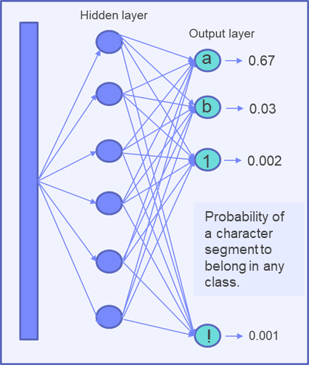
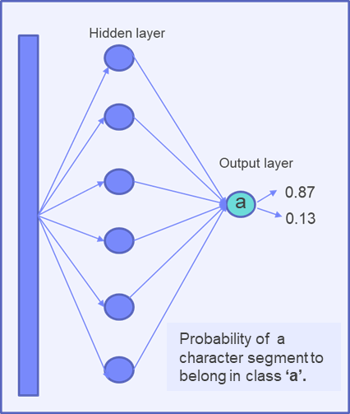
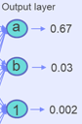
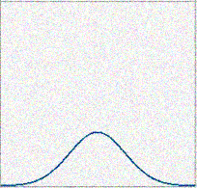
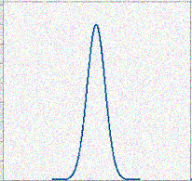
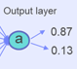
Technical Solution and preferred embodiment
Classifiers – Step 2
Multiclass Classification
vs
Binary Classification
The second step of this phase is to select the number of classes/characters that the model will be able to identify. The selected method is the binary classification , which means that the CNN will only operate for 2 classes. Hence, 94 models were created, one for each character. The output of each model is the probability of an image being a specific character or not. The decision to adapt a binary classifier instead of a multiclass one, it emerges for the principles of their corresponding activation functions. Logistic and Softmax, respectively. The variance of the probability density function it increases while more classes are added in the analysis.Thus, the curve becomes more flatten and the distinguish between the classes is almost impossible. Finally, the segmented character will be classified by the model with the minimum outputted probability in the negative class (not being this character).
vs
Softmax
Logistic

Slide 53
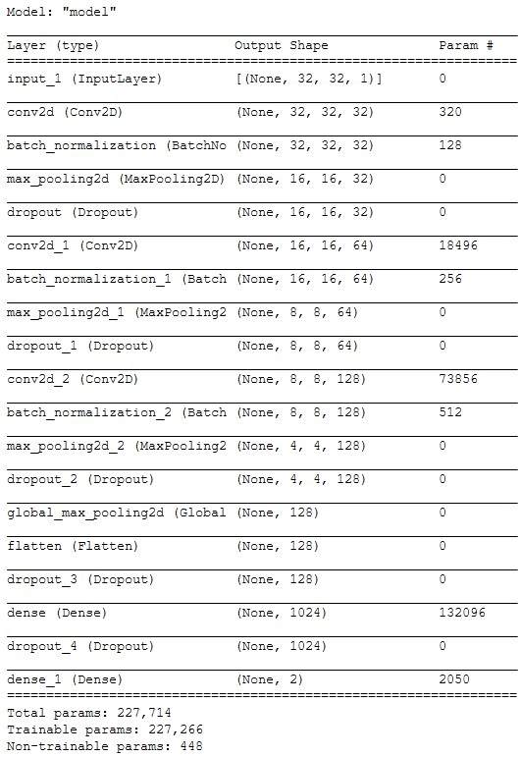
Technical Solution and preferred embodiment
Classifiers – Step 2.1
Architecture demonstration of the binary CNN character classifier.

Slide 54

Technical Solution and preferred embodiment
Classifiers – Step 3
The third step of this phase is to decrease the workload of the character detection CNNs and improve their forecasting accuracy. To achieve this, another binary CNN classifier was created that distinguishes between alphanumeric and symbols characters. Hence, the algorithm first identifies the type of the segmented character and then, it invokes the corresponding character detection CNN models for the actual classification. We named this method “gradually classifier” , because the exact class is identified using consecutive steps. Like this, the type of error range is reduced by either 69.6% or 30.4%, since the scoring models are reduced by this number, respectively. The accuracy of this binary CNN is almost 100%.
62 - alphanumeric characters
‘A-Z’ + ‘a-z’ + ‘0-9’
32 - symbol characters
'!', '"', '#', '$', '%', '&', "'", '(', ')', '*’, '+', ',', '-', '.', '/', ':’, ';', '<‘, '=', '>’, '?', '@', '[', '\\', ']', '^', '_', '`', '{', '|', '}', '~’

Slide 55
Technical Solution and preferred embodiment
Classifiers – Step 4
r
&
k
&
K
The fourth step of this phase is to auto-correct the False Positive recognitions and automatically improve the accuracy of our OCR solution. During our experiments we identified pairs of characters that the CNNs fail to efficiently distinguish and thus,the False Positive rate it increases. For some of these specific pairs, specialized CNNs were trained, and they are applied after the main character detection process to correct the classification. For the rest pairs , fuzzy algorithms are applied in next phase. This is a dynamic process and is expected to identify and correct more pairs while the solution is tested.
0
&
O
&
o
m
&
n
:
&
%
-
&
=
.
,
&
"
&
‘

Slide 56


Technical Solution and preferred embodiment

Slide 57
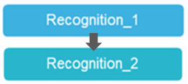








Technical Solution and preferred embodiment
Recognition_1_2 – Step 1
The first step of the recogntion phase it to bring each candidate segment in the appropriate scoring format. To do so ,morphological operations are applied. There are 2 versions of preprocessed images created.
Input
Version 1
Version 2
Version 1 : the segmented character is adjusted based on its horizodal contours.This version is used at the final Post- Classification phase. It supports the distigusish of characters based on their relative character position in the image. Version 2 : the segmented character is adjusted based on its horizodal and vertical contours and is resized to fit the CNN design requirements. Ths version is the most efficient for the CNN recognition performance.

Slide 58
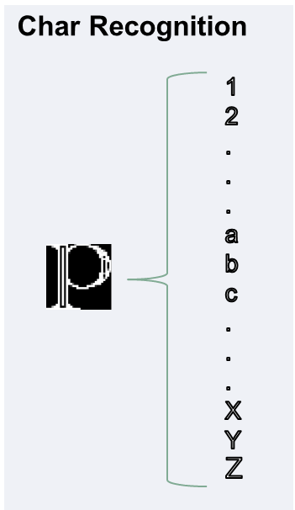
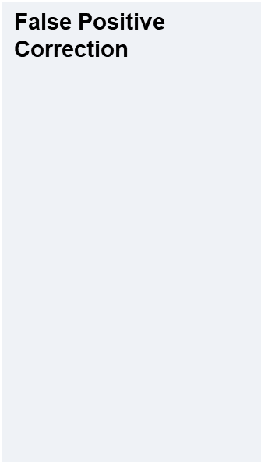
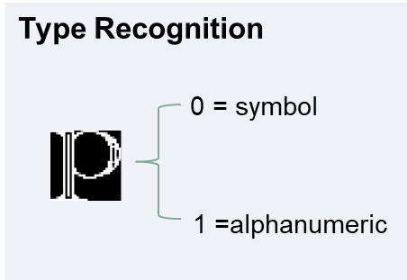

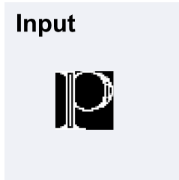


Technical Solution and preferred embodiment
Recognition_1_2 – Step 2
In the second step of this phase all the previous described CNN classifiers are combined to identify the character label. The created models are running seperately, and hence, they can take advantage of the parallel computing practises for execution effciecy.
Start
letter
Type
Cha
END
FP
Segment
Type
Detection
Char
Detection
False
Positive
Example
k
r
K

Slide 59

Technical Solution and preferred embodiment

Slide 60
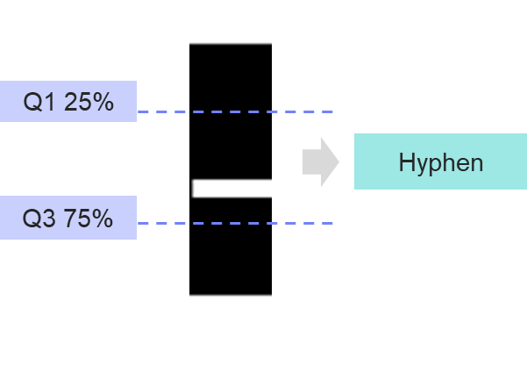
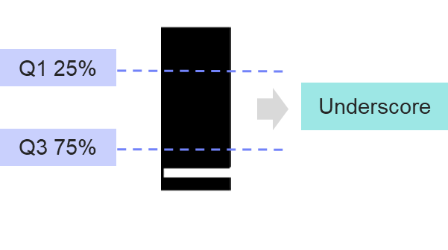
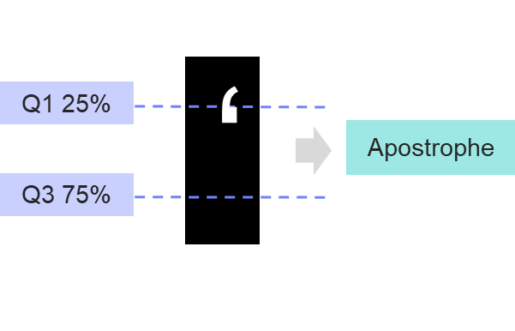

Technical Solution and preferred embodiment
Post – Classification – Step 1
As we already mentioned ,during our experiments we identified pairs of characters that the CNNs fail to distinguish because they share similar geomterical attributes. At this level, fuzzy algorithms were created to correct the False Positive classifications based on the character´s relative position in the image. For this task , the non-rised images are used (version 1) , because they contain the spatial information. This is a dynamic process and is expected to identify and correct more pairs while the solution is tested.

Slide 61

Technical Solution and preferred embodiment

Slide 62


Technical Solution and preferred embodiment
Results JSON – Step 1
{
‘image id’ : 'ex_007.png’,
‘line coordinates’ : [[36, 41, 128, 49],
[60, 74, 127, 81],
[8, 103, 127, 111],
[145, 40, 171, 50],
[144, 71, 200, 81]]
‘subcoordinates’ : [[5, 10, 14, 26],
[15, 16, 24, 26],
[25, 16, 31, 26],
[33, 16, 41, 26] ,
[42, 16, 48, 26]......]
‘recognition': [[ ‘F‘, ‘a‘, ‘z‘, ‘e‘, ‘r‘ ].......]
}
The final output of the process is a JSON dictionary with the following keys:
image id: the id of the input image line coordinates : the relative position coordinates of the line or word sergment based the initial input image.We keep this information for our key-value pairs future studies. subcoordinates : the relative position coordinates of the character based on its corresponding line or word segment. This information is used for the final text represenation and to support an RPA process. recognition: the identified character

Slide 63
Technical Solution and preferred embodiment
Process Diagram – Training
Process Diagram – Recogntion
Which Characters?
Start
Input Image
Detect Objects
Detect Lines
Start
Generate Base Training Data
Characters
Quantity
Detect Words
Yes
Uneven
Text ?
Type
Classification
Start Recognition by Character
Detect Characters
No
Retrain
GAN?
Yes
Retrain GAN
Generate GAN Training Data
Add Manual
Data
Character
Classification
No
No
False Positive - Pair ?
Generate GAN Training Data
Manual
Data ?
No
Train CNN
Yes
Fuzzy Char Detection
Yes
Spatial Related ?
No
CNN Pair Char Classification
Yes
Add Manual Labeled Data
Merge
Results
Train CNN
End
Store JSON
End

Slide 64
Technical Solution and preferred embodiment
Results Tesseract
Results Tesseract
Results Our Solution
Accuracy per Character
Accuracy per Character
Inaccurate in our sample
93.9%
Noise passed
Noise passed
3%
0.3%
Accuracy per text Object
95.5%
Accuracy per Character: Accuracy of the model by individual character. Noised passed: Amount of redudant information scored as segment characters or generated by the algorithm. Accuracy per Object: Accuracy of Tessearct by scoring the whole text objects.There is some time series correction. U

Slide 65


Examples

Slide 66



Examples

Slide 67


Examples

Slide 68

Examples

Slide 69


Examples

Slide 70


Examples

Slide 71



Examples

Slide 72
Technical Inventive Steps
We have highlighted in the “technique” as detailed between slides 6 to 62 the innovative steps.
The overall sequence of steps and processing decisions ( for eg. in step 1 a decision was made to not use deliation and erosion operations so as to allow suitable processing downstream ) are crucial for the improved accuracy which was benchmarked against the most popular open-source OCR package available Tesseract.
The overall flow of the algorithm is detailed in slide 62
Use of GAN’s as outlined in slides 46-48 is not found in prior art and significantly improves our accuracy of the overall algorithm.
The ensemble CNN techniques as we outlined between slides 53 and 59 are also unique with no parallels in prior art.
Notes:
Note ; the technical inventive could be re-used in the search string (for the next step – prior art search).
The search string must be a summary with the minimal set of innovative stuff

Slide 73
Keywords
To potential fuel the discussion, pprovide (5 to 10) keywords that characterize uniquely your idea, and that could be used to search for Prior Art.
Optical character recognition in low resolution images.
Character segmentation using 3-color channel images.
Character segmentation using color dimensionality reduction.
Character segmentation for intersected text
Character segmentation of intersected letters using time series principles.
Character Classification using trained CNN with synthetic text-to-image data.
Character Classification using trained CNN with synthetic data from Generative Adversarial Neural Networks.
Optical character recognition system with process steps , implemented as apis.

Slide 74
Claims
What is claimed is:
The method of claim 1, wherein the text in the image dilated dynamically based on the image size following an exponential growth. (core)
The method of claim 1, wherein each phase the segments are extracted from the original image and the preprocessing steps are adapted based on the phase requirements.(core)
The method of claim 1, wherein sparse text in line segments is identified and segmented further to words.
The method of claim 1, wherein the characters are segmented using 3 channel colors images.
The method of claim 1, wherein the image color dimensions are reduced used color distance measures.
The method of claim 1 , to detect and remove underlines from the image text.
The method of claim 1 , wherein the characters are segmented based on pixels chronologic behavior.
The method of claim 2, wherein image is binarized black background and white text to direct the gradient descents and hence, the learning rate closer to the understudy text for the CNN classifiers.
The method of claim 2, wherein Generative adversial NN are used to increase noise and variation in the training dataset.
The method of claim 2, wherein the characters are classified based on 94 binary classifiers.
The method of claim 2, wherein the characters are gradually hierachical classified to their actual class.

Slide 75
Claims
What is claimed is:
The creation of a quite generic character detection system for computer applications.
The creation of a quite generic OCR algorithm for computer applications, that automatically identifies the coordinates of each text character and efficient returns the recognition independently of the page formatting.
The method of claim 2, wherein image is inverted binarized (values 1 for text and 0 for the background) to direct the gradient descents and hence the learning rate closer to the text for the CNN classifiers.
The method of claim 1, wherein the text in the image deliated based on the image attributes.
The method of claim 1, wherein the image noise is slightly gradually removed to guarantee that text is not affected.
The method of claim 1, wherein each phase the segments are extracted from the original image and the preprocessing steps are adapted based on the phase requirements.
The method of claim 1, wherein sparse text in line segments is identified and segmented further to words.
The method of claim 1, wherein the characters are segmented using 3 channel colors images.
The method of claim 1, wherein the image color dimensions are reduced used color distance measures.
The method of claim 1 , to detect and remove underlines from the image text.
The method of claim 1 , wherein the characters are segmented based on pixels chronologic behavior.
The method of claim 2 , wherein training dataset is provided as in-memory api.
The method of claim 2, wherein Generative adversial NN are used to increase noise and variation in the training dataset.
The method of claim 2, wherein the characters are classified based on 94 binary classifiers.
The method of claim 2, wherein the characters are gradually hierachical classified to their actual class.

